Slide 1
Data Structure
Arrays, Records and Pointers
Mohammad Gazi Golam Faruque
Associate Professor
Department of Computer Science and Engineering
KHWAJA YUNUS ALI UNIVERSITY

Slide 2
Related CLOs
Course Learning Outcome (CLO)
CLOs | After successful completing this course, students will be able to. | PLO Mapping
CLO1 | Understand the concept of data structures to apply the algorithm for solving problems. | PO1, PO2
CLO2 | Choose a suitable algorithm to organize the data in several structure in computer. | PO4, PO5
CLO3 | Implement the various data structure algorithm for solving real-life problems. | PO2, PO3
CLO4 | Develop the new sustainable data structure to solve the upcoming problems. | PO12
CLO5 | Explore the various operations of linear, non-linear and dynamic data structures. | PO3, PO12

Slide 3
Discuss Topics
Arrays, Records and Pointers

Slide 4
Introduction
Data structures are classified as either linear or nonlinear.
A data structure is said to be linear if its elements form a sequence, or, in other words, a linear list.
There are two basic ways of representing such linear structures in memory.
One way is to have the linear relationship between the elements represented by means of sequential memory locations.

Slide 5
Array Operation
The operations one normally performs on any linear structure, whether it be an array or a linked list, include the following:
Traversal. Processing each element in the list.
Search. Finding the location of the element with a given value or the record with a given key.
Insertion. Adding a new element to the list.
Deletion. Removing an element from the list.
Sorting. Arranging the elements in some type of order.
Merging. Combining two lists into a single list.

Slide 6
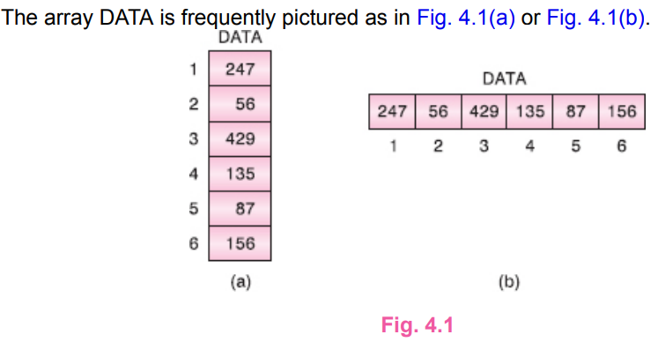
LINEAR ARRAYS
A linear array is a list of a finite number n of homogeneous data elements,
The elements of the array are referenced respectively by an index set consisting of n consecutive numbers.
The elements of the array are stored respectively in successive memory locations.
The number n of elements is called the length or size of the array.

Slide 7
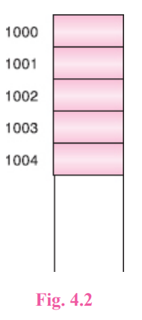
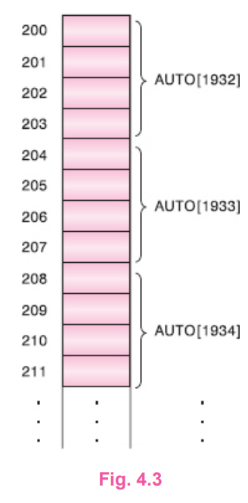
REPRESENTATION OF LINEAR ARRAYS IN MEMORY
Let LA be a linear array in the memory of the computer. Recall that the memory of the computer is simply a sequence of addressed locations as pictured in Fig. 4.2. Let us use the notation
LOC(LA[K]) = address of the element LA[K] of the array LA

Slide 8
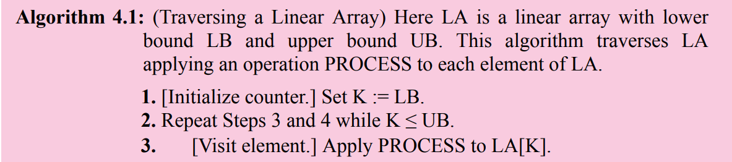

TRAVERSING LINEAR ARRAYS

Slide 9
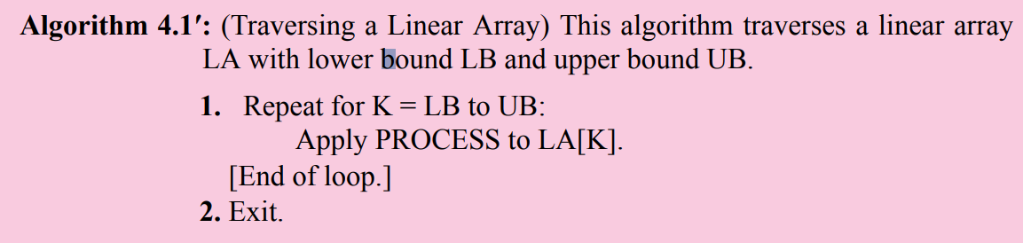
TRAVERSING LINEAR ARRAYS

Slide 10
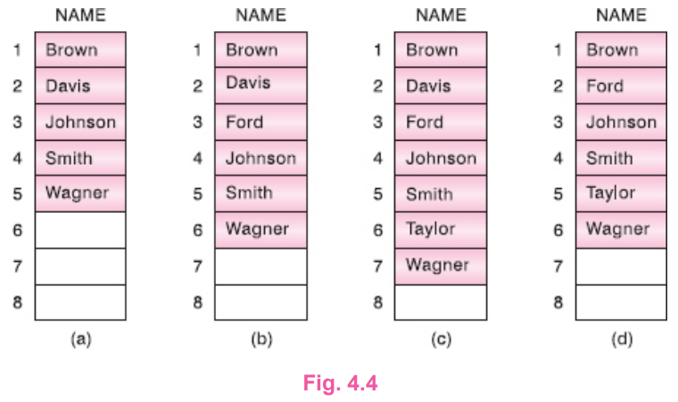
INSERTING AND DELETING

Slide 11
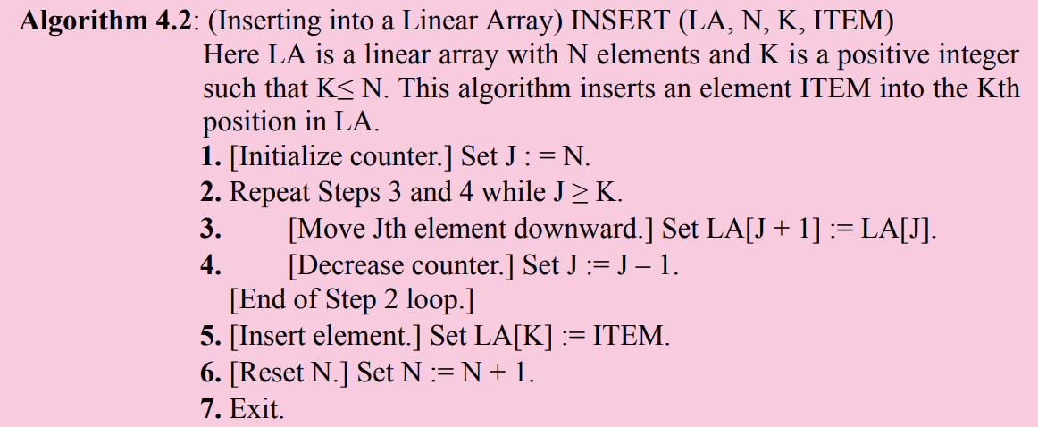
INSERTING AND DELETING

Slide 12
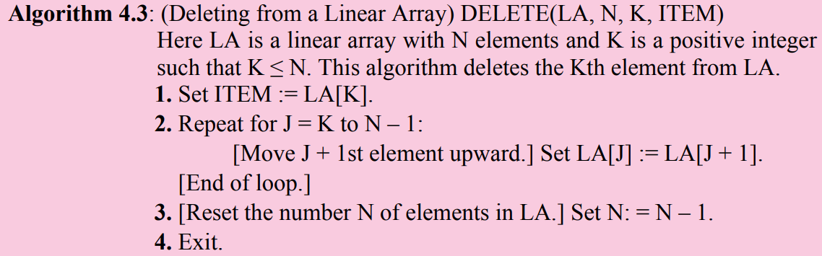
INSERTING AND DELETING

Slide 13
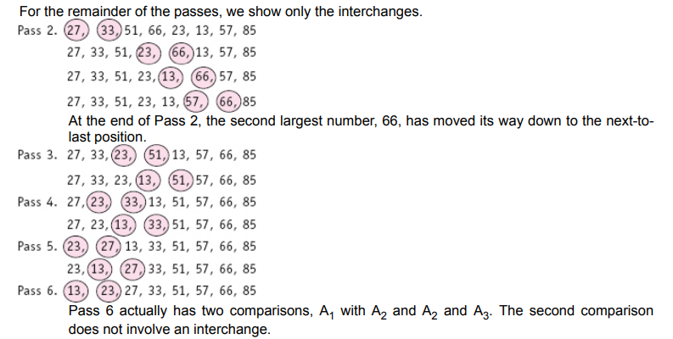
SORTING: BUBBLE SORT

Slide 14
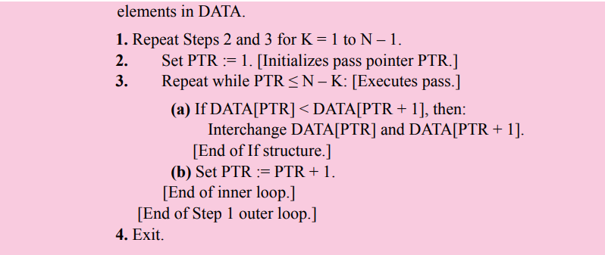
SORTING: BUBBLE SORT

Slide 15
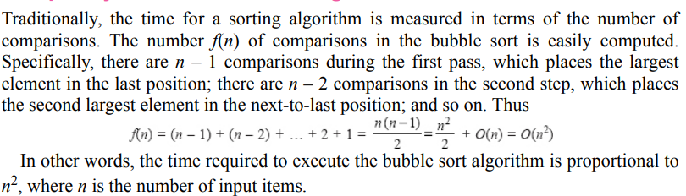
Complexity of the Bubble Sort Algorithm

Slide 16
Linear Search
Suppose DATA is a linear array with n elements. Given no other information about DATA, the most intuitive way to search for a given ITEM in DATA is to compare ITEM with each element of DATA one by one. That is, first we test whether DATA[1] = ITEM, and then we test whether DATA[2] = ITEM, and so on. This method, which traverses DATA sequentially to locate ITEM, is called linear search or sequential search. To simplify the matter, we first assign ITEM to DATA[N + 1], the position following the last element of DATA. Then the outcome
LOC = N + 1
where LOC denotes the location where ITEM first occurs in DATA, signifies the search is unsuccessful.

Slide 17
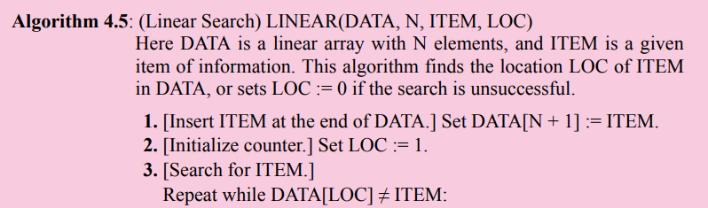

Linear Search

Slide 18
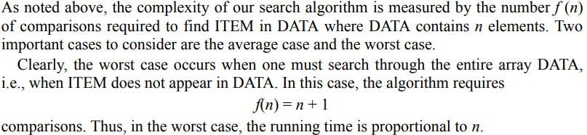
Complexity of the Linear Search Algorithm

Slide 19
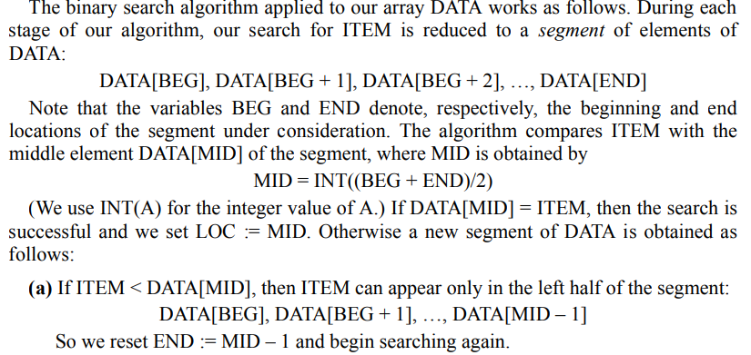
BINARY SEARCH

Slide 20
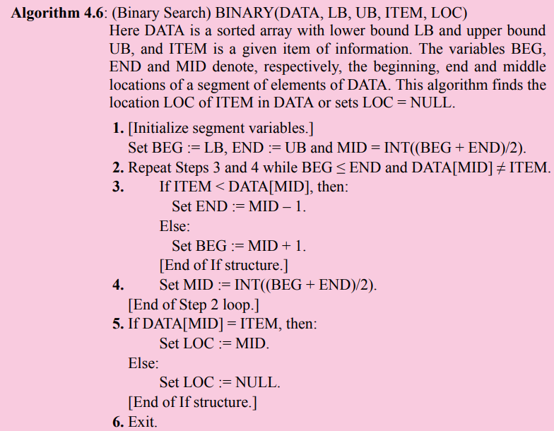

Slide 21
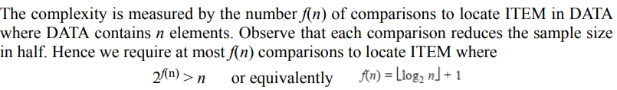

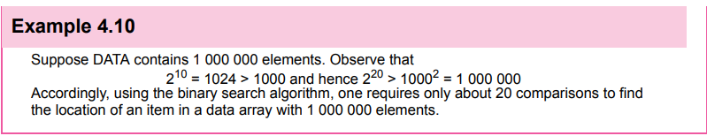
Complexity of the Binary Search Algorithm

Slide 22
Limitations of the Binary Search Algorithm
Since the binary search algorithm is very efficient (e.g., it requires only about 20 comparisons with an initial list of 1 000 000 elements), why would one want to use any other search algorithm?
Observe that the algorithm requires two conditions:
(1) the list must be sorted and
(2) one must have direct access to the middle element in any sublist.
This means that one must essentially use a sorted array to hold the data. But keeping data in a sorted array is normally very expensive when there are many insertions and deletions.
Accordingly, in such situations, one may use a different data structure, such as a linked list or a binary search tree, to store the data

Slide 23
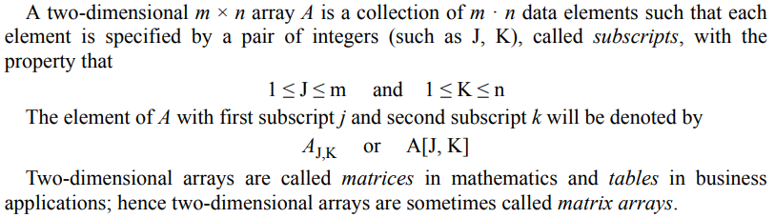
MULTIDIMENSIONAL ARRAYS
Two-Dimensional Arrays

Slide 24
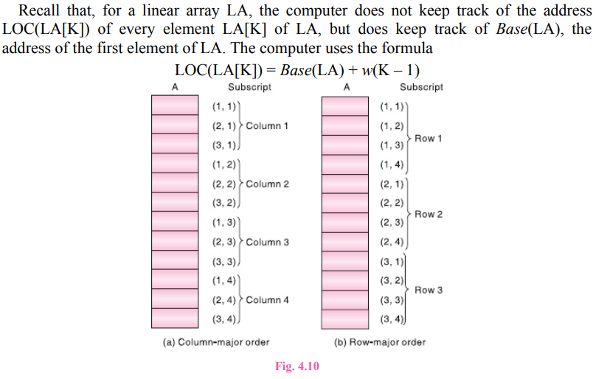
Representation of Two-Dimensional Arrays in Memory

Slide 25
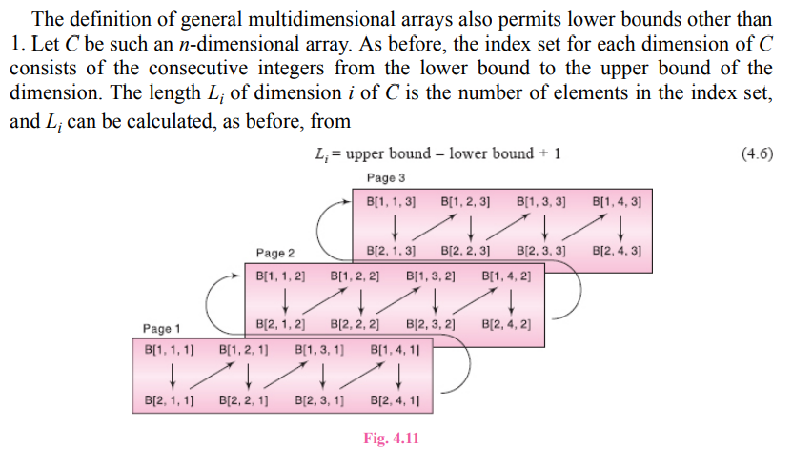
General Multidimensional Arrays

Slide 26
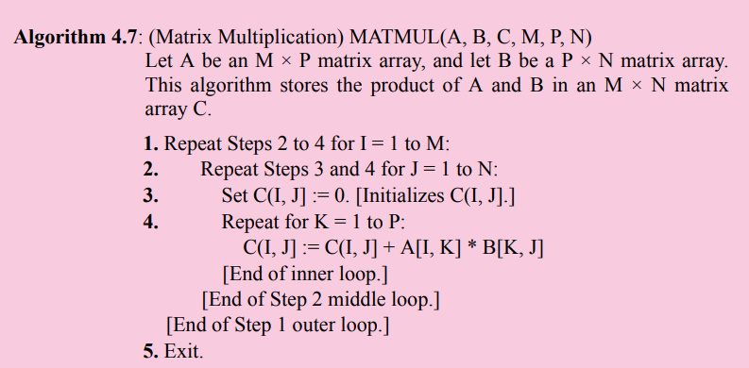
MATRICES

Slide 27
Important Sample Questions
Solve Problems: 4.1 to 4.14 (All Problems)
Supplementary Problems: 4.1 to 4.10 (All Problems)

Slide 28
Next Week Topics
Linked List

Slide 29
Thank You

